Slide 1
Structure and Phase Response of Neurofilament-Heavy Protein Brushes
Takashi Yokokura
Wang Group Meeting
04/01/2022

Slide 2
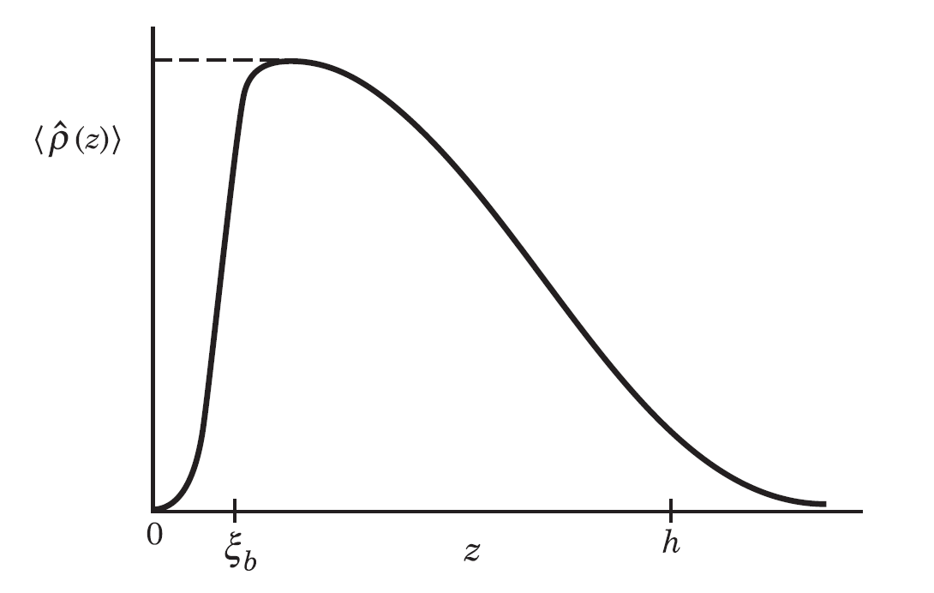
Motivation – Polymer Brushes
Represent an extremely rich space within the polymer field, with or without embedded charge
Theoretical work pioneered by de Gennes (1980) and both theoretically and numerically progressed by
Fleer, Leermakers (SFbox, Neurofilament)
Borisov, Zhulina (Homopolymer & weak PE phase transitions, applications of SFbox)
Height (H)

Slide 3
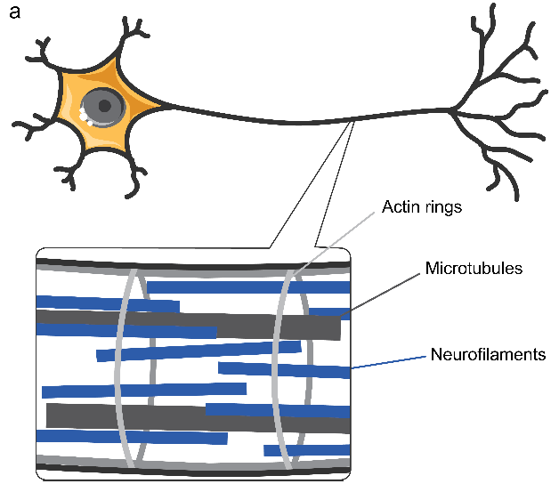
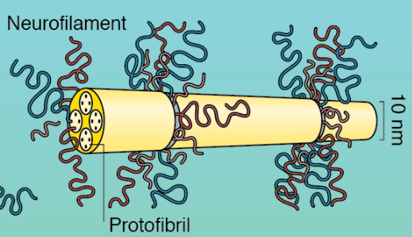
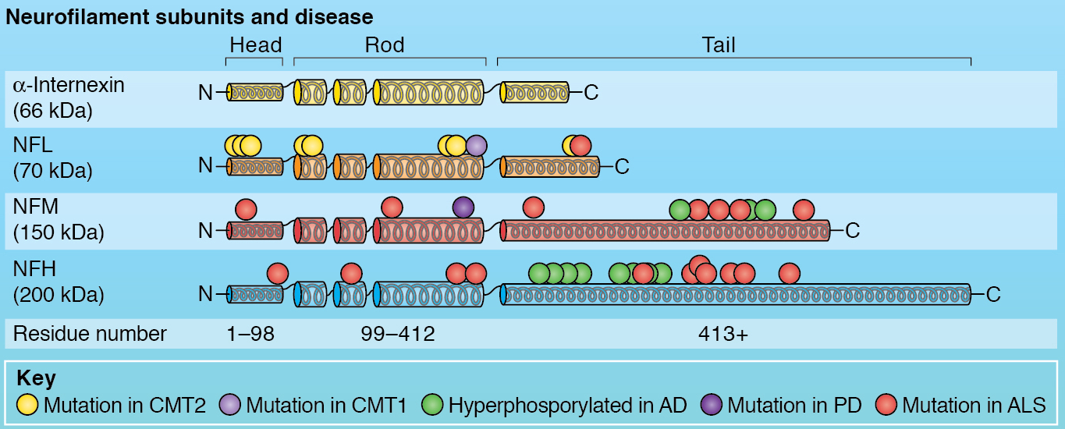
Motivation – Neurofilaments
Neurofilaments are protein brushes present within the axon of the neuron and determine the structural rigidity of the axon
Found to be a common site of mutations within patients of neurodegenerative diseases such as Alzheimer’s Disease and Parkinson’s Disease.
Figure Credit: Erika Ding
Yuan, Rao, Nixon. (2012). Neurofilaments at a Glance. J Cell Sci. 125 (14): 3257–3263.

Slide 4
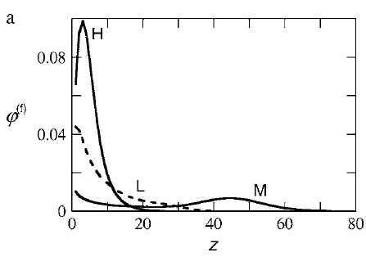
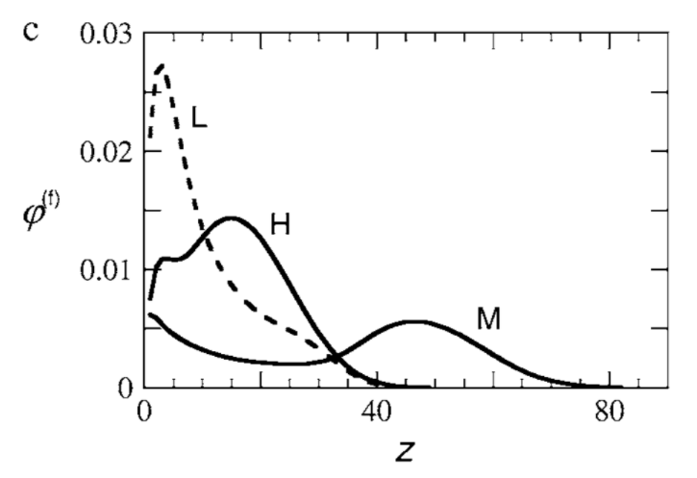
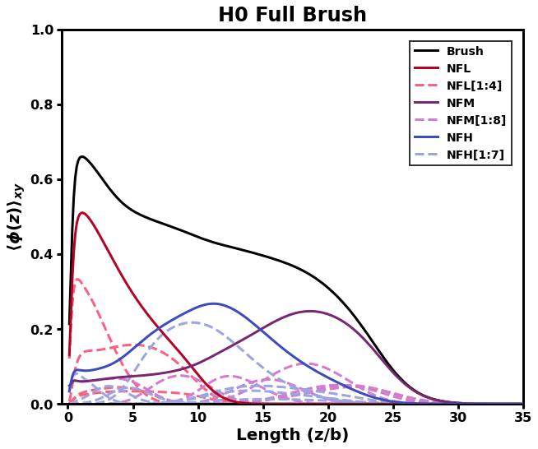
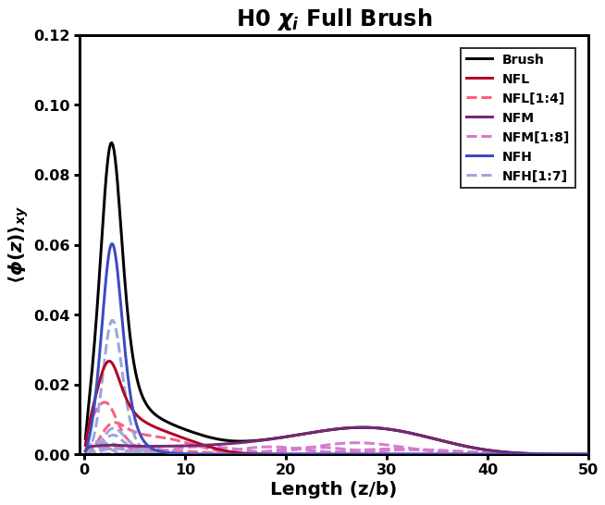
Motivation – Neurofilaments
Our model was able to reproduced existing published SCF results on the internal structure
Presented in my previous group meeting
Zhulina and Leermakers, Biophys. J., 93, 2007

Slide 5
Overview
Model
SCF derivation
Charge distribution coarse-graining
NFH Brush
Validation using Srinivasan et al., 2014
Conformational behavior and structure
Extensions
Multiple peaks
Binary NF brush
Local pH consideration
Conclusions

Slide 6
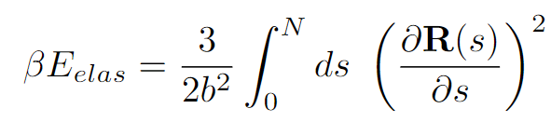
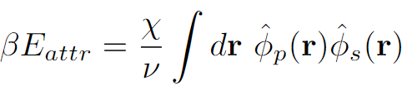
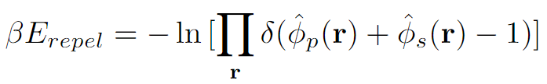
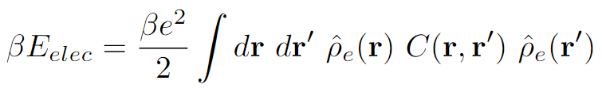
Model – SCF Review
Goal: Adapt framework for free polyelectrolyte in solution to model end-grafted protein brushes in solution
Interactions:
Elastic entropy following Gaussian statistics
Flory-Huggins 2-body interactions
Incompressibility
Electrostatics, ignoring any correlations

Slide 7
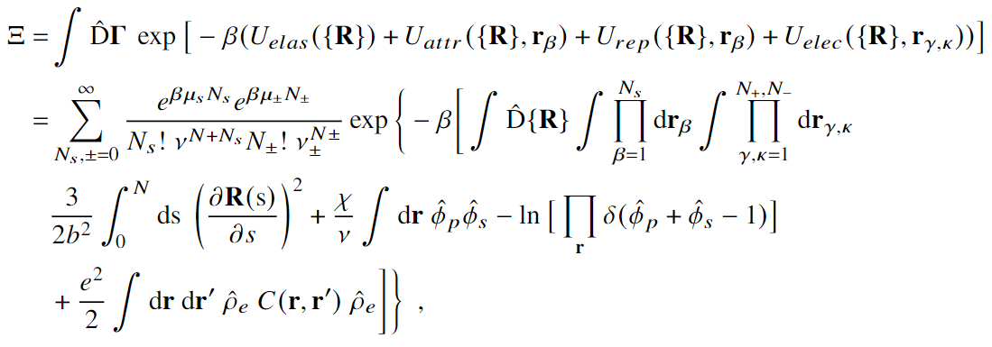



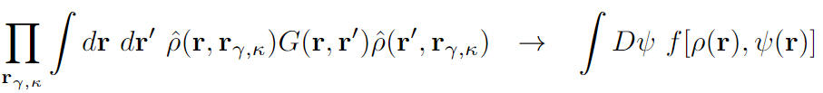

Model – SCF Review
Semicanonical partition function
Canonical in polymer, grand canonical in ions and solvent
Block copolymer approximation
Particle-to-field transformations
Hubbard-Stratonovich transformation
Saddle-point approximation

Slide 8
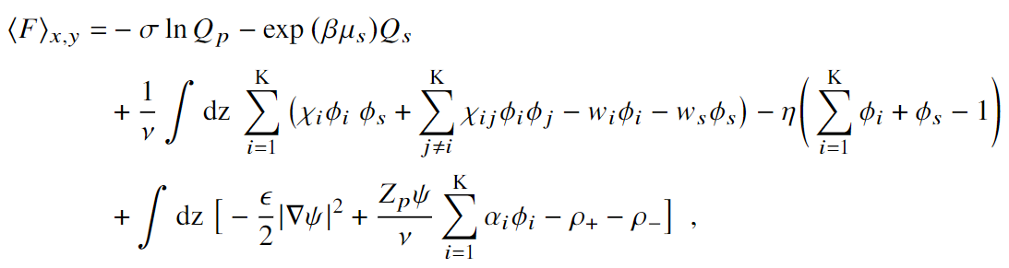



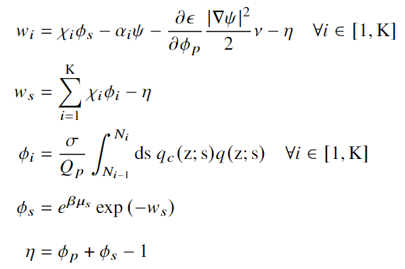
Model – SCF Review
Variational Free Energy
After statistical average over grafting surface (x-y plane)
Functional Minimization
SCF Equations

Slide 9
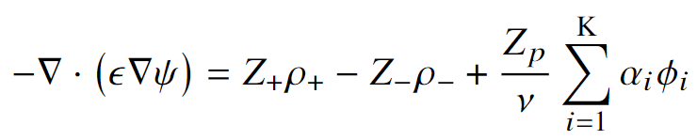
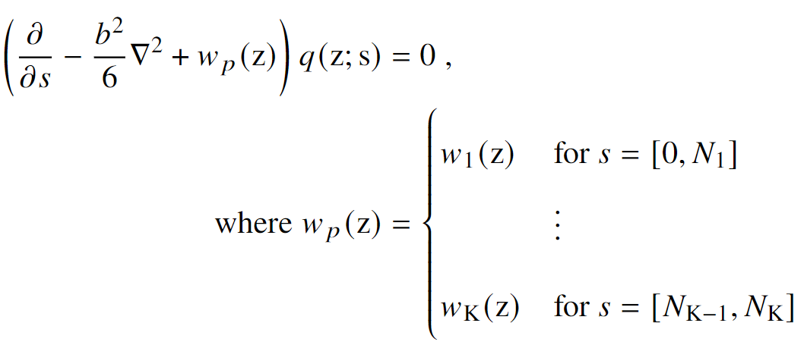

Model – SCF Review
Satisfied Equations
Mean-field Poisson-Boltzmann Equation
Modified Diffusion Equation
Block K
$$\{χ_{K},N_{K}, α_{K}\}$$
Block 2
Block 1

Slide 10
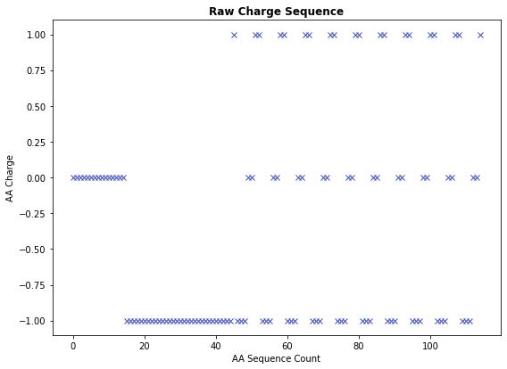
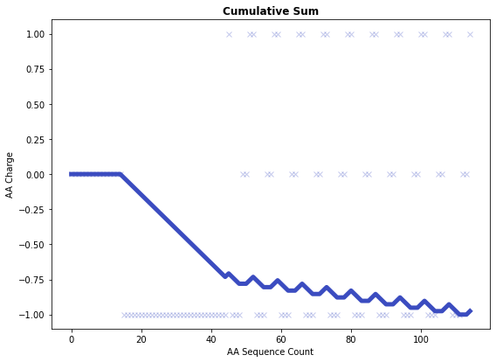
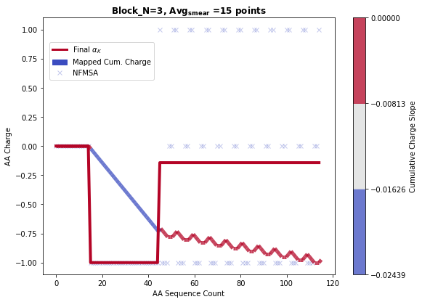
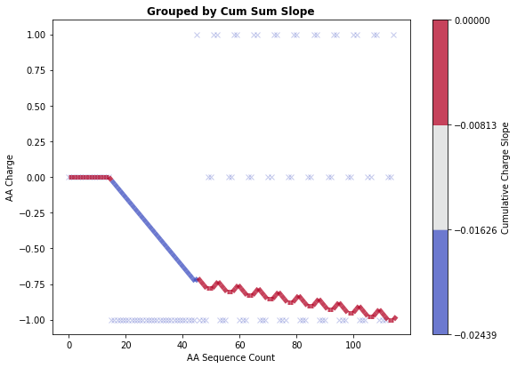
Model – Coarse-graining Method
Coarse-graining performed by grouping charges based on contributions to the slope of the cumulative charge
Hyperparameters: Number of bins, Minimum number of AA per block
Sample sequence:
HHHHHHHHHHHHHHH DDDDDDDDDDDDDDDDDDDDDDDDDDDDDD KDDDHHK KDDDHHK KDDDHHK KDDDHHK KDDDHHK KDDDHHK KDDDHHK KDDDHHK KDDDHHK KDDDHHK

Slide 11
Overview
Model
SCF derivation
Charge distribution coarse-graining
NFH Brush
Validation using Srinivasan et al., 2014
Conformational behavior and structure
Extensions
Multiple peaks
Binary NF brush
Local pH consideration
Conclusions

Slide 12
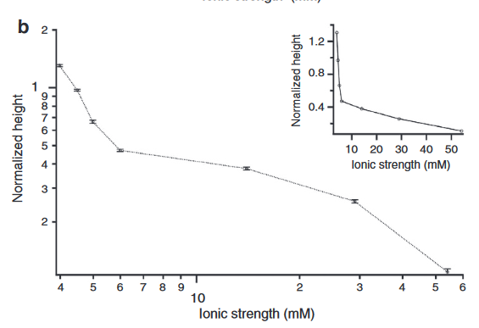

NFH Brush – Previous Experiment
Ongoing (separate) collaboration with Erika Ding, PhD Candidate in Kumar Group
Neurofilament-Heavy (NFH) sidearms grown by E. coli and grafted onto a planar surface as an “intrinsically disordered protein brush” for use as biomaterial (flow valves, smart sensors, etc.)
Measured height response at various pH and salt concentrations
All following results will be for the response to salt concentration at constant pH = 2.40
Low and constant pH minimizes the amount of charge annealing in weak PE

Slide 13
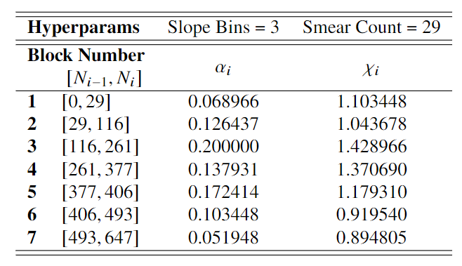
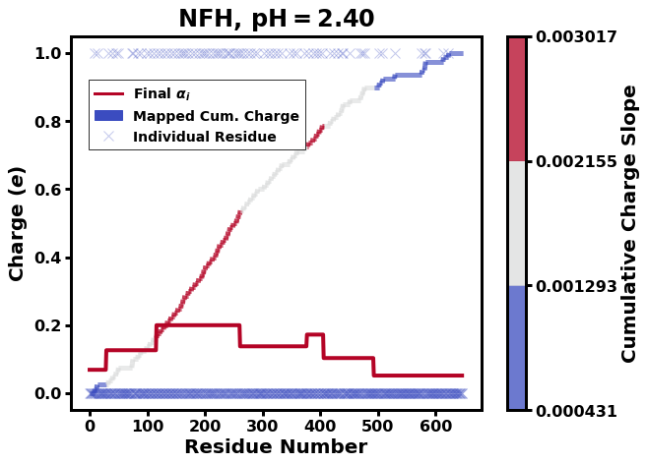
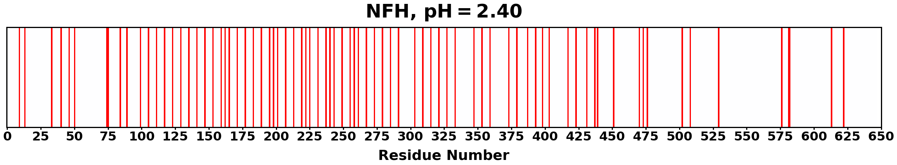
NFH Brush – Coarse Graining

Slide 14
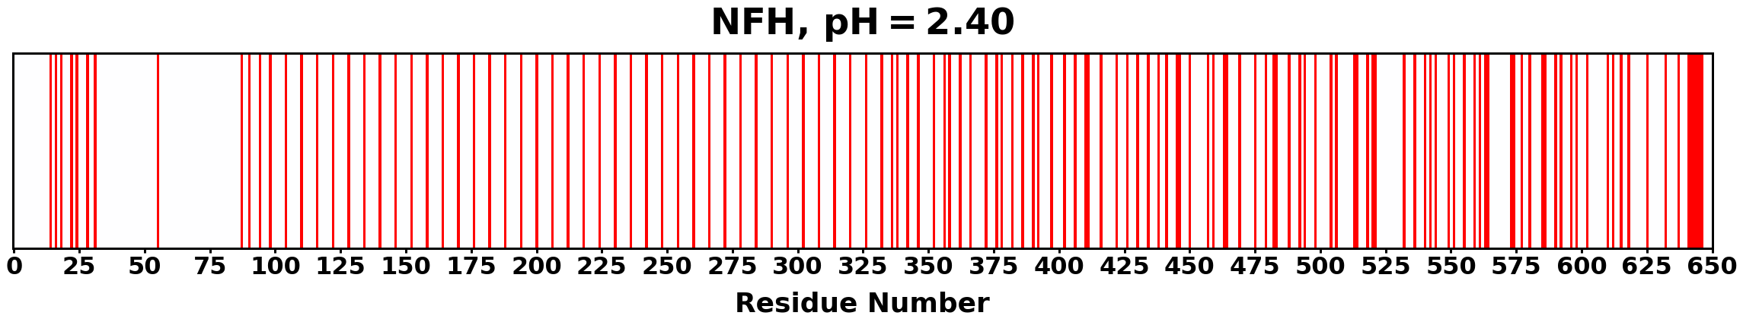
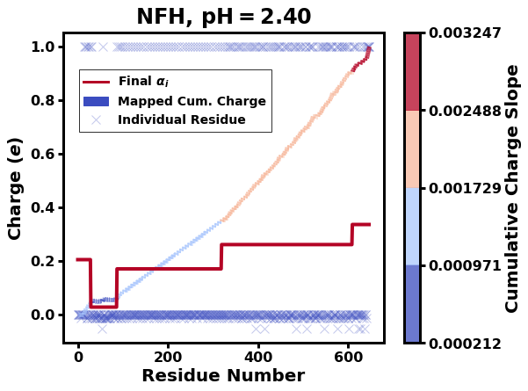
Corrected - 20220722
Old:

Slide 15
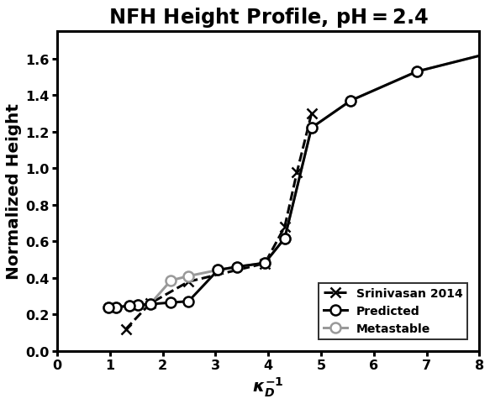

NFH Brush – Experimental vs. Predicted
Very good match (excellent if metastable used)
Sharp transition properly reproduced
Plot reports impossible ionic strengths given current pH
At pH = 2.4,
Extended curves give more insight into polymer conformation (as shown on next slide)

Slide 16
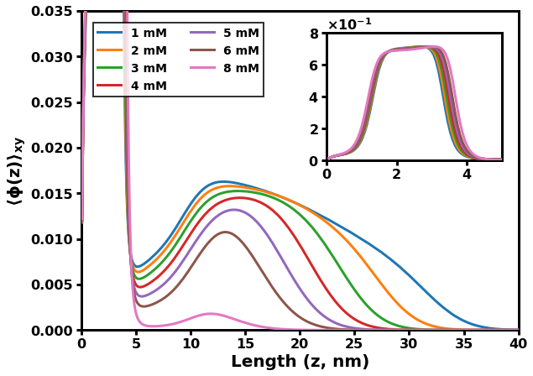
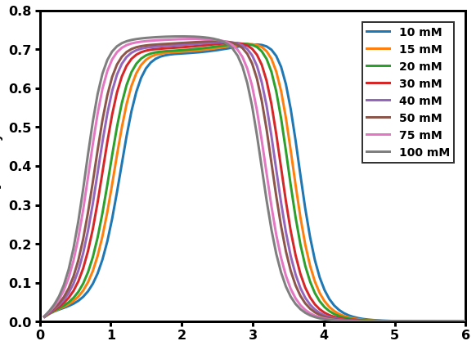
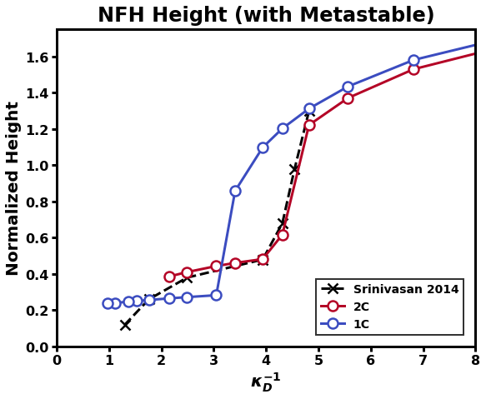
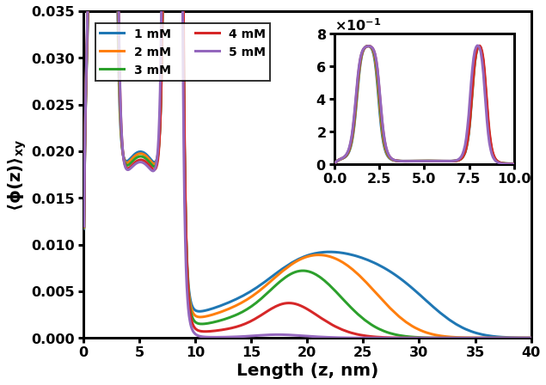
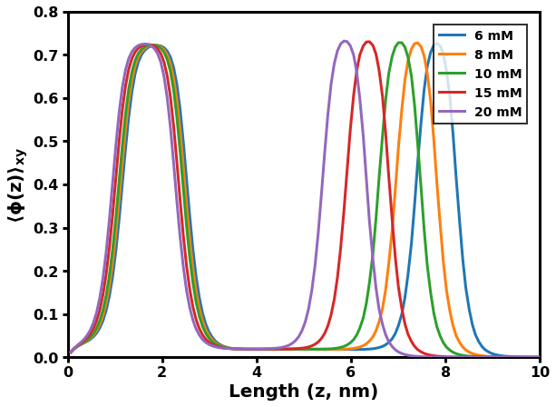
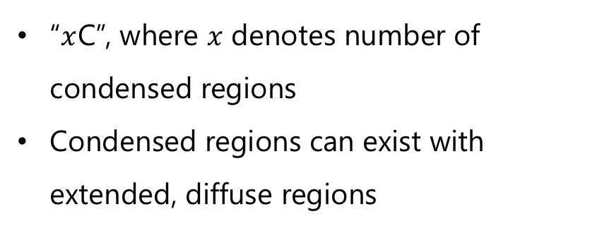
NFH Brush – Conformational Competition
“$x$C”, where $x$ denotes number of condensed regions
Condensed regions can exist with extended, diffuse regions
1C
2C

Slide 17
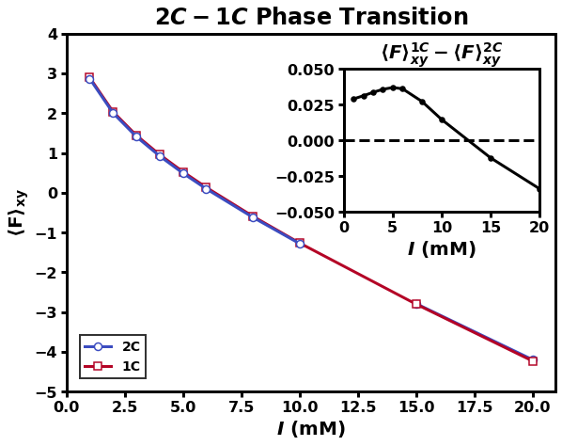
NFH Brush – Phase Transition Order
2nd Order
1C
1st Order
2C
2nd Order from Collapsed to Collapsed-Coil
Globule to Coil
1st Order between 1C and 2C
Sphere to Pearl-Necklace
2nd Order

Slide 18
NFH Brush – Internal Structure
What is the underlying structure of this new, phase segregated conformation?
Same chains in both phases (pn-like)
Phases contain different chains
(expelled)
Segments can fluctuate between layers
Segments “locked” into layers
Overall density profiles will look identical

Slide 19
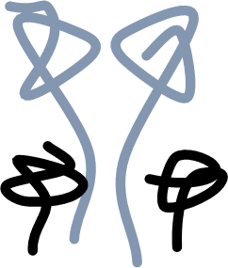
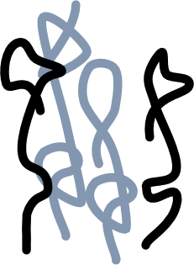
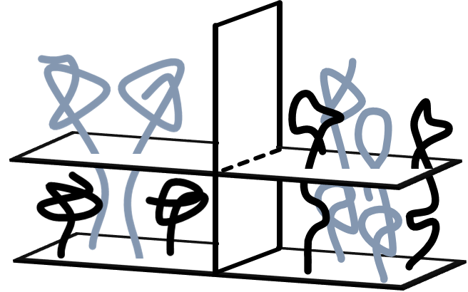
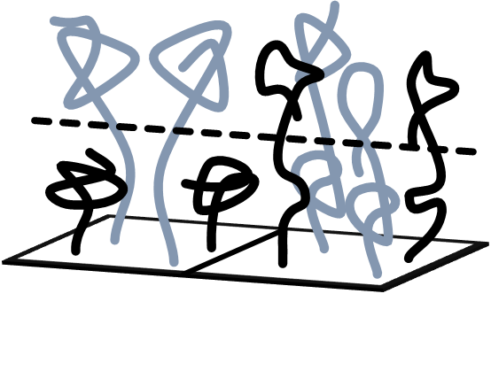
compact
Left right spread
picture
picture

Slide 20
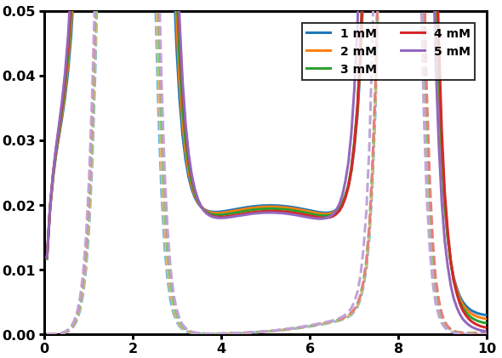
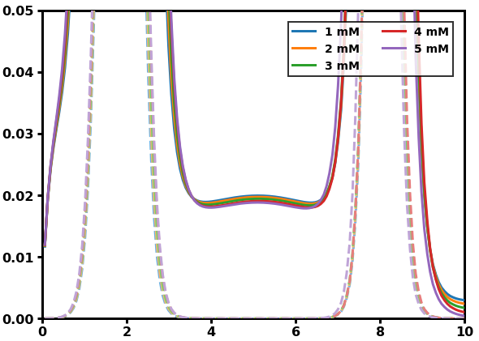
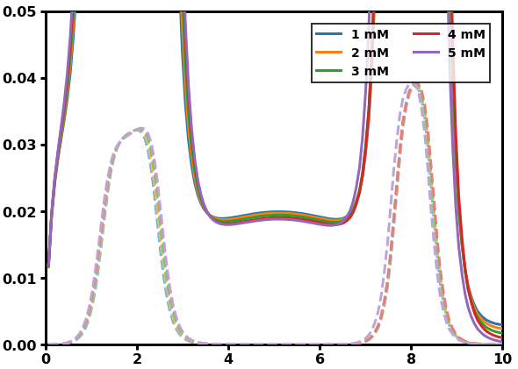
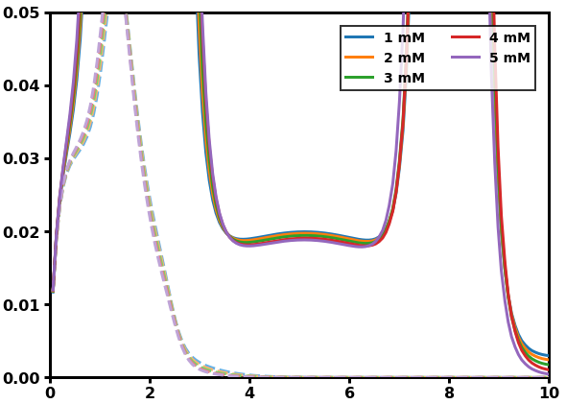
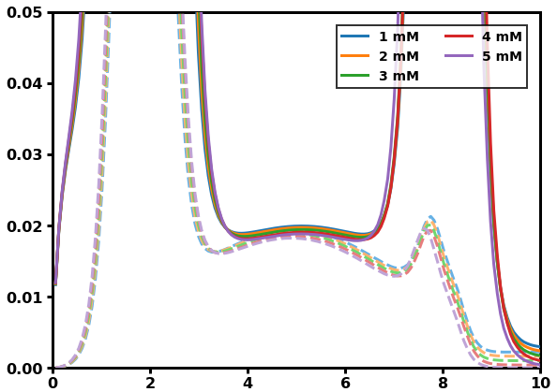
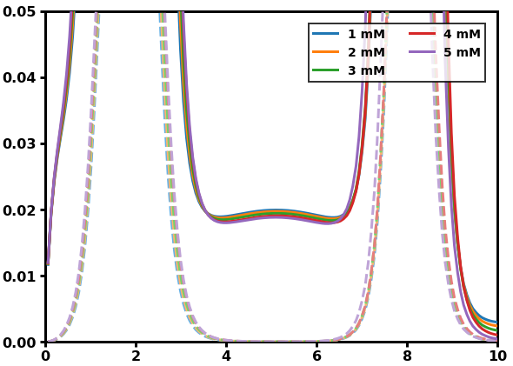
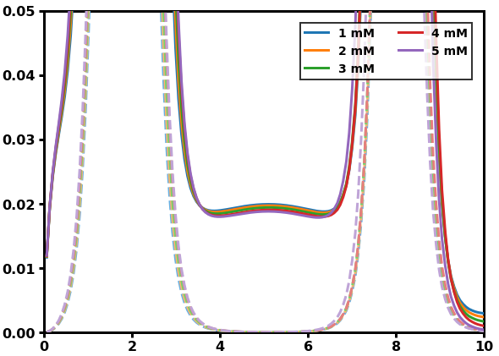
NFH Brush – Internal Structure
Block decomposition of 2C can discern between structures
3
4
5
1
2
6
7
3–7
2
1

Slide 21
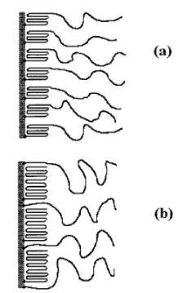
NFH Brush – Internal Structure
Same concept for dilute, coil phase
Previously demonstrated theoretically (for 1C only)
(Colors added to emphasize phase segregation, not to denote statistically distinguishable chains)
Adapted from Klushin, Birshtein, Amoskov. Macromolecules, 2001.

Slide 22

NFH Brush – Internal Structure
How does internal structure affect response to salt concentration?
Dramatic collapse
Cooperative collapse

Slide 23
Overview
Model
SCF derivation
Charge distribution coarse-graining
NFH Brush
Validation using Srinivasan et al., 2014
Conformational behavior and structure
Extensions
Multiple peaks
Binary NF brush
Local pH consideration
Conclusions

Slide 24
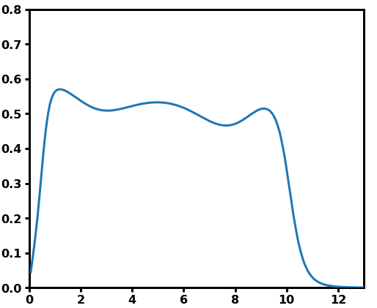
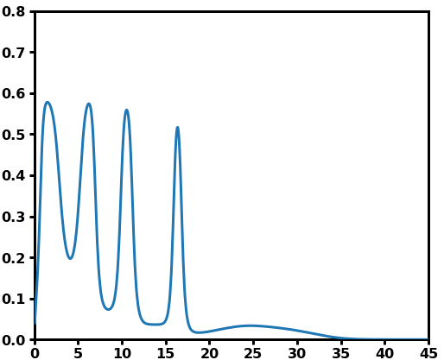



Extensions – $x$C
$x=1, 2, 3, …$
Multi-peak profiles are preliminary, but suggest a much richer space than previously thought (no previous mention of multiple condensed layers that I could find)

Slide 25

Extensions – Binary NF Brush
NF in biological systems contain a blend of H, M, L profiles
Why are compositions not consistent across location in the nervous system and neuronal development?
How do the compositions affect accessible conformations?
Do different compositions respond to stimuli differently?
Experimental collaborators can systematically measure height vs. binary (and ternary in the future) composition
(Preliminary data)

Slide 26







Extensions – Local pH
Charge distribution of weak PE in dilute brushes (e.g. NF) are sensitive to local pH
For systems at low H+ concentration (e.g. physiological conditions), local pH differs significantly from bulk conditions
Local degree of dissociation
Bulk pH
Brush electric potential
Local pH
Dissociation constant
Curves represent bulk salt concentrations
pH = 7
pKa = 7
(Israels, Leermakers, Fleer. Macromolecules, 1994)

Slide 27
Overview
Model
SCF derivation
Charge distribution coarse-graining
NFH Brush
Validation using Srinivasan et al., 2014
Conformational behavior and structure
Extensions
Multiple peaks
Binary NF brush
Local pH consideration
Conclusions

Slide 28
Conclusions
We have successfully applied our framework to single-component brushes of NFH when local pH is not a factor
Drastic changes in NFH height at low ionic concentrations are due to a second-order phase transition from 2C-coil to 2C
Further collapse can be explained by a first-order phase transition from 2C to 1C
Blocks determined by cumulative charge coarse-graining can give insight on internal structure
A multitude of subsequent projects can be addressed with minor adjustments to the framework (e.g., multi-chain, dissociation reactions, self-energy, etc.)

Slide 29
Thank you!

